Slide 1
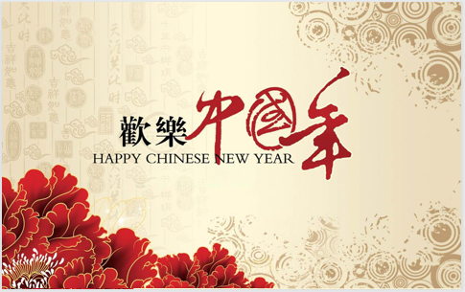
亚历克上 -M202161029

Slide 2

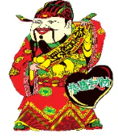
Spring Festival
Shì zhōngguó zuì zhòngyào de jiérì.
Tā zài 1 yuè xiàxún zhì 2 yuèchū qìngzhù (shì niánfèn ér dìng).
Shíwù zài zhōngguó xīnnián qìngzhù huódòng zhōng qǐ zhuó zhòngyào zuòyòng.
Hóngsè zài zhōngguó suíchù kějiàn, yīnwèi:
- Hóngsè qūxié.
Is the most important holiday in China.
It is celebrated in late January to early February (depending on the year).
Food plays a major role in Chinese New Year celebrations.
Red can be seen and felt everywhere in China because:
- Red expels evil, driving bad things away.

Slide 3

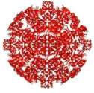
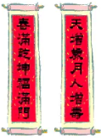
Symbols
Jiǎnzhǐ yìshù-yóu hóng zhǐ zhì chéng, shàngmiàn xiězhe hēisè de zhōngguó shūfǎ.
Hóngsè xiǎo xìnfēng
“xìngyùn qián”
yǐ hūn dàrén gěi háizi zhuāng mǎn “xìngyùn qián” de hóngbāo
Paper - cut art - made of red paper with black Chinese calligraphy written on them.
Red small Envelopes
“Lucky money”
Married adults give children red envelopes filled with “lucky money”
Duìlián——hóngsè duìlián zuòwéi měilì de zhuāngshì pǐn hé hùshēnfú.
Couplet - The red couplets serve as beautiful decorations and protective talismans.

Slide 4
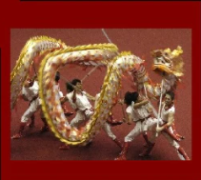
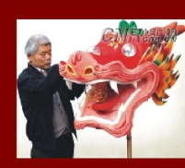
Dragon dance
Chuántǒng shàng, zài nónglì xīnnián, liǎng gèrén chuānzhuó jùdà de lóng fúzhuāng tiàowǔ.
Traditionally , on Chinese New Year, two people wear a huge dragon costume and dance.

Slide 5
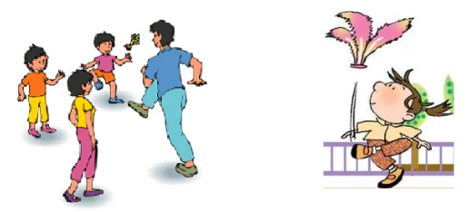
Activity- Jianzi
Yī zhǒng qǐyuán yú gōngyuán qián 5 shìjì de zhōngguó yóuxì.
Tā zhǔyào zài nónglì xīnnián qíjiān bòfàng.
A game originated from 5th century BC in China.
It is mainly played during Chinese New Year.

Slide 6
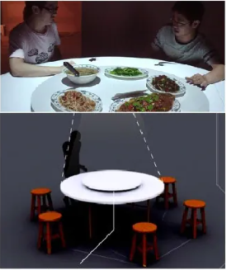
Sharing the meal (turntable table)
Gàiniàn:
-Tā yǐ yǒuqù de shìjué xiàoguǒ jiāqiángle chuántǒng de cānzhuō lǐyí.
Zhuō shàng de jiāoliú lèqù.
conception:
-It strengthen the traditional table manners with the amusing visual effects.
Communication pleasure on the table.

Slide 7
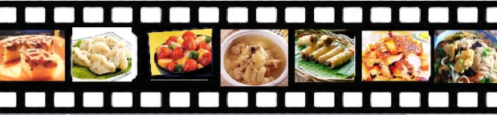
Auspicious food
Zài nónglì xīnnián, rénmen huì liǎojiě nǎxiē shíwù huò càiyáo xiàngzhēngzhe hǎo yùn, yǐjí wèishéme tāmen bèi rènwéi shì xìngyùn de.
Hot Pot
Fish
Dumplings
Green vegetables
Sticky rice cake
Noodles
On Chinese New Year , people learn which certain foods or dishes symbolize good fortune and why they are considered to be lucky.

Slide 8
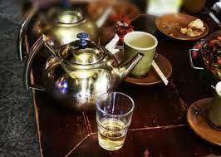
Menu idea
3 Zhǒng bùtóng de càidān gēnjù qián 7 míng jíxiáng shípǐn.
Gōngyìng zhōngguó chá, dàn yě kěyǐ suíyì gōngyìng jiǔjīng.
Bèijǐng yīnyuè hé chá.
3 different menu according to the Top 7 auspicious food.
Serve Chinese tea, but feel free to serve alcohol as well.
Background music and tea.

Slide 9
Thank you for your attention!
Gǎnxiè nín de guānzhù!

